Slide 1
Speaker Identification Using MFCC and Logistic Regression
Presented by:
Khondker Sayif Ali (2111323642)
Md. Injamam ul Haque (2111598642)
Nashita Tasneem Noor (2132126642)

Slide 2
What is Speaker Identification?
Identifying who is speaking from audio clips
Used in smart assistants, authentication, and more

Slide 3
Project Goal & Motivation
Goal: Identify speakers from Bengali speech samples
Use Python + MFCC + Logistic Regression
Applies to voice-based security systems

Slide 4
Tools & Environment
Google Colab
Python libraries: librosa, scikit-learn, matplotlib
Google Drive for storage and access

Slide 5
Recording Script & Dataset
10 Bengali sentences used
Collected using Google Form
Saved as WAV files, one folder per speaker

Slide 6
Data Collection Progress
4 speakers completed
Each has 2 short .wav files
Folders: speaker1/, speaker2/, etc.

Slide 7
Folder Structure
MyDrive/
└── speech_dataset/
├── speaker1/
├── speaker2/
└── ...

Slide 8
Feature Extraction - MFCC
MFCC = Mel-Frequency Cepstral Coefficients
13 features per clip extracted using librosa
Mean MFCC vector computed per clip

Slide 9
Modeling Pipeline
Mount Drive and load audio files
Extract MFCC features from each .wav file
Encode speaker labels
Train Logistic Regression model

Slide 10
Train/Test & Accuracy
Split data: 80% training, 20% testing
Initial test accuracy: {75%-100%} (depends on Datatset)
Verified MFCC extraction and speaker labels

Slide 11
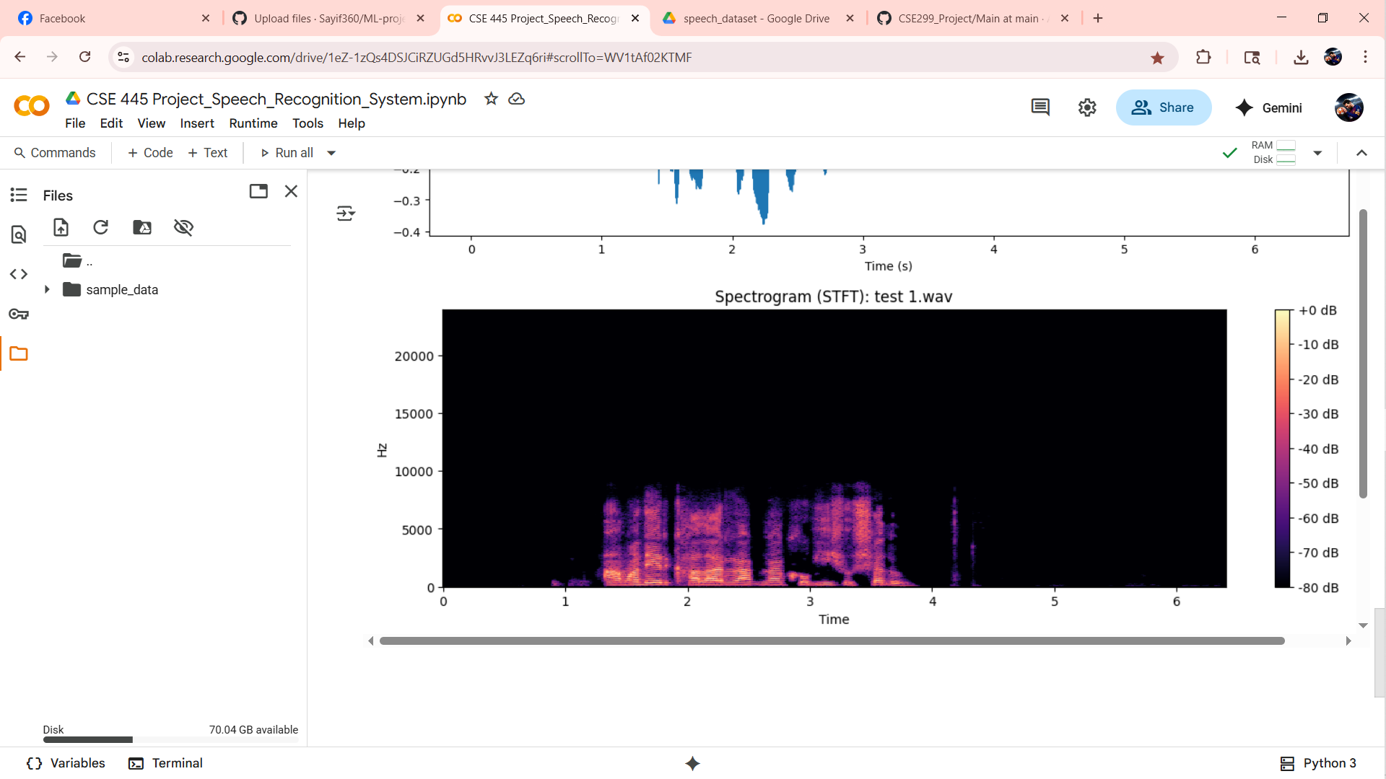
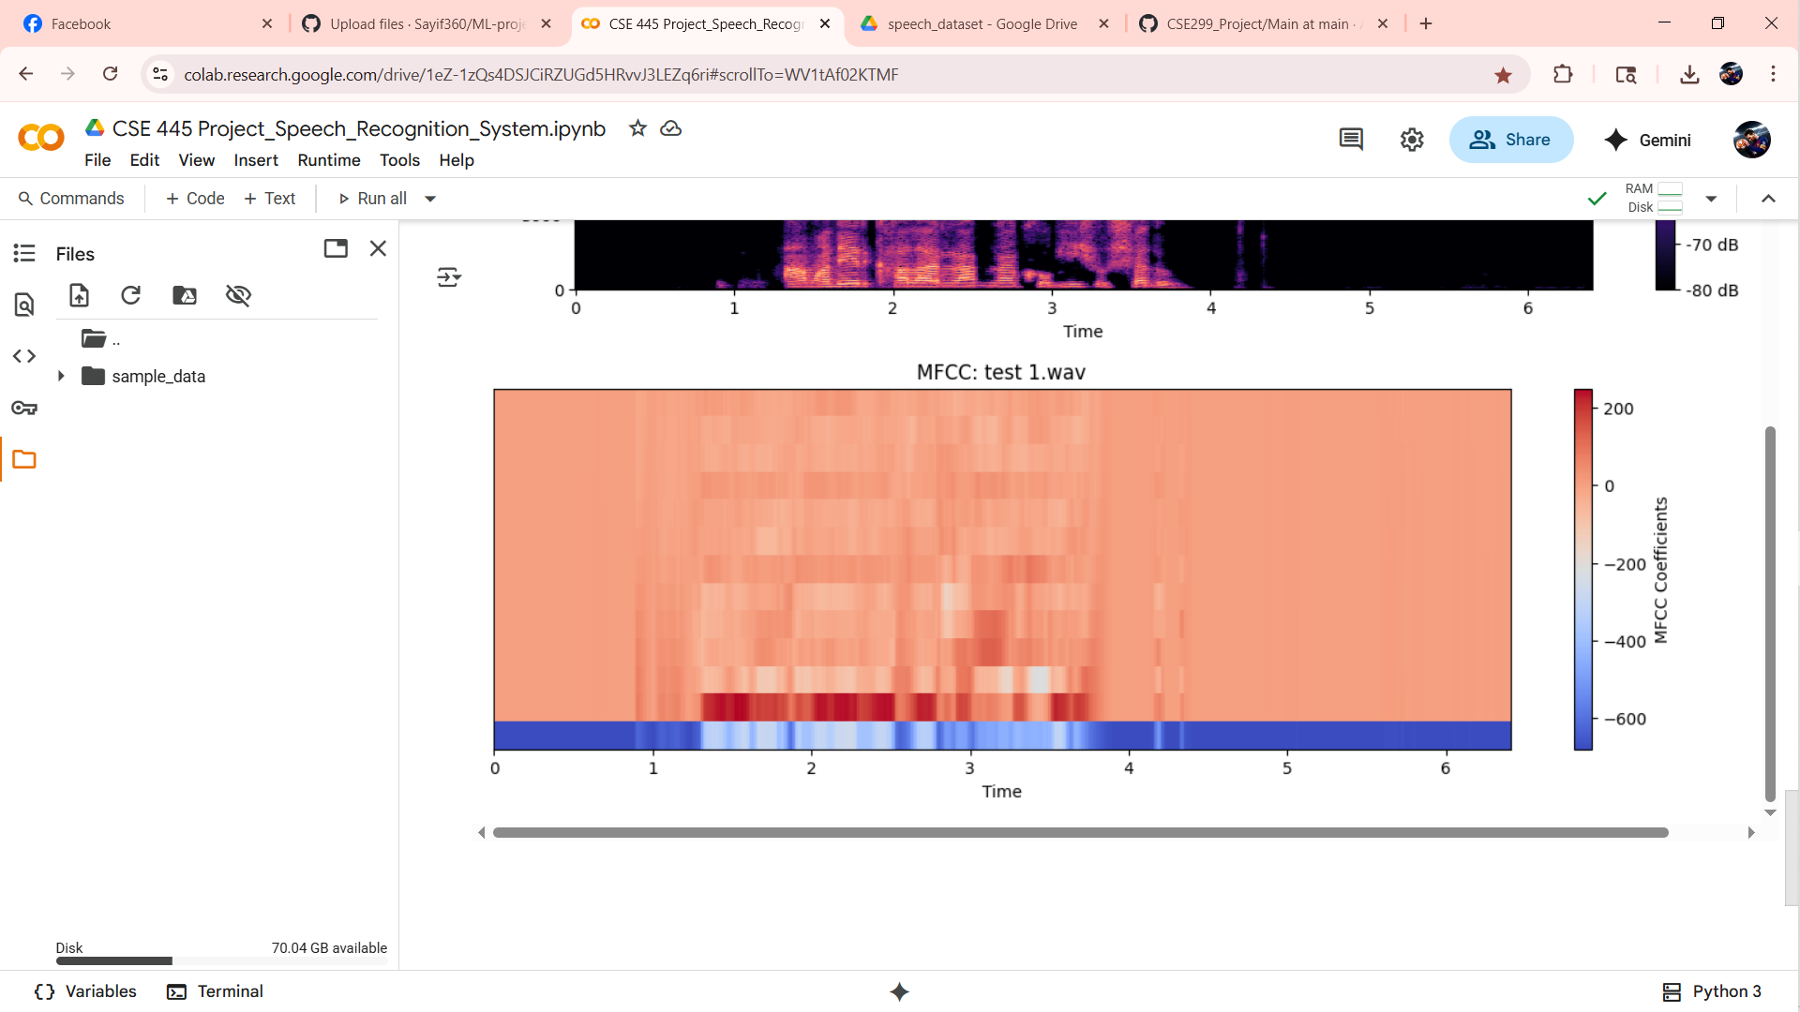
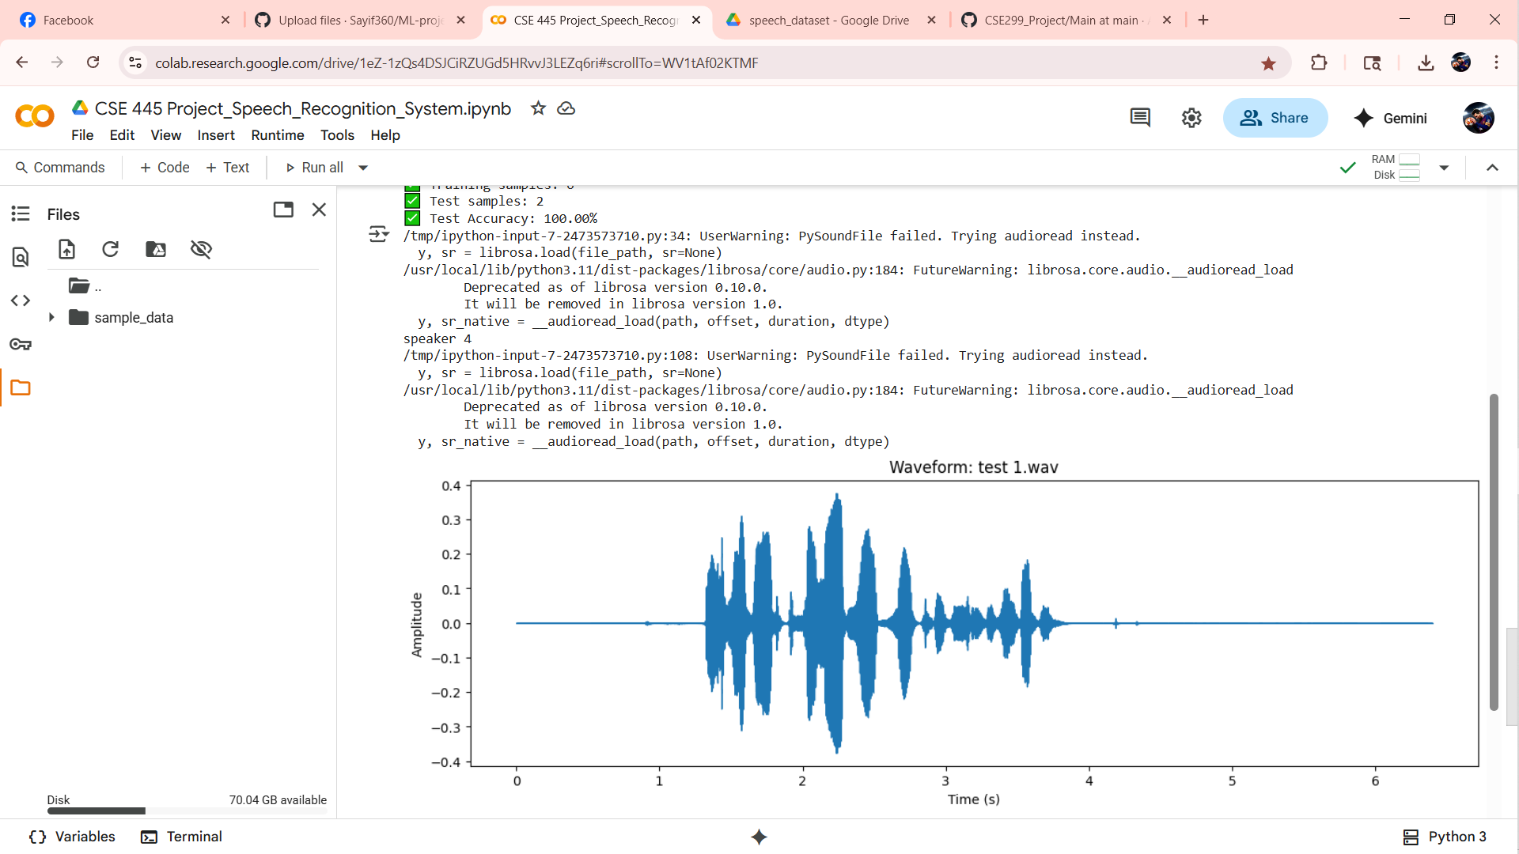
Visualizations
Waveform of speech signal
Spectrogram (STFT)
MFCC heatmap
Screenshots

Slide 12
Prediction Example
Function: predict_speaker(file_path)
Model predicts speaker ID

Slide 13
Challenges Faced
Delay in speaker submissions
Background noise in some audio
Inconsistent file naming and organizing

Slide 14
Next Steps
Collect 6 more speakers
Add more samples per speaker
Try KNN or SVM models
Finalize report & create live demo

Slide 15
Thank You / Q&A
Thanks for your attention!
Questions?

